Slide 1
Week 5 (1) – Depth-First Search
CST370 – Design & Analysis of Algorithms
Dr. Byun
Computer Science

Slide 2
Lecture Objectives
After completion of this lecture, you will be able to
  perform the depth-first search (DFS) to visit all vertices of a graph.

Slide 3
Chapter 3: Brute Force and Exhaustive Search
3.1 Selection Sort and Bubble Sort
3.2 Sequential Search and Brute-Force String Matching
3.3 Closest-Pair and Convex-Hull Problems by Brute Force
3.4 Exhaustive Search
3.5 Depth-First Search and Breadth-First Search

Slide 4
Depth-First Search (DFS) Algorithm
To get the basic idea of DFS, watch this video.
  https://www.youtube.com/watch?v=iaBEKo5sM7w

Slide 5
<<< Course Instruction >>>
Read pages 122-125 in the textbook and proceed to the next slide.
  The YouTube video uses a stack to describe the operation of DFS.
  In addition to the stack, our textbook also uses a "mark" for each vertex to indicate whether the vertex has already visited or not.
  Furthermore, our textbook describes the concepts of "depth-first search forest", "tree edges", and “back edges".

Slide 6
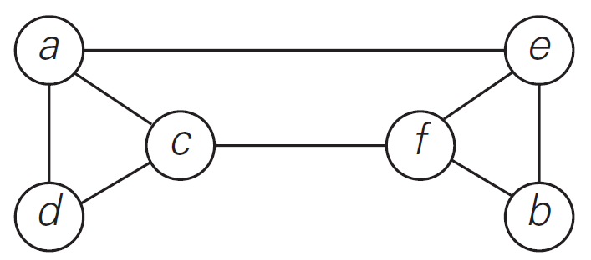
Example
Starting at the vertex a, present the sequence of vertices the DFS algorithm will visit.
  Also present a DFS tree with only "tree edges".

Slide 7
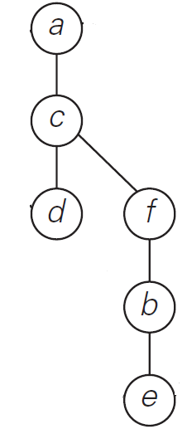
Solution (1 of 2)
Sequence of vertices to be visited
  a → c → d → f → b → e
DFS tree with only "tree edges".
Watch this video for detailed explanation.
  https://www.youtube.com/watch?v=Hv8Gjp2zpCY

Slide 8
Solution (2 of 2)
The order in the DFS tree is not important.
  So, the following tree is good as well.
a
c
f
d
b
e

Slide 9
Exercise
Starting at the vertex a, present the sequence of vertices the DFS algorithm will visit.
  Also present a DFS tree with only "tree edges".
Do not see the answer immediately.
  Try to solve it by yourself.
a
b
c
d
e
f
g
h

Slide 10
Exercise Solution
DFS Tree
a
1
a
b
2
c
6
b
d
7
e
4
f
g
f
3
g
5
e
c
h
8
Mark
d
h

Slide 11
DFS – Time Efficiency
The time efficiency of the DFS algorithm depends on the data structure used to represent the graph.
  For the adjacency matrix representation, the traversal time is in Θ(|V |²).
  For the adjacency list representation, it is in Θ(|V | + |E|) where |V | and |E| are the number of the graph’s vertices and edges, respectively.
  When analyzing other graph algorithms, you should consider two representations in most cases.
Watch the video below for a more detailed explanation.
  https://www.youtube.com/watch?v=T6pAtlEpm_o

Slide 12
Applications of DFS
Checking connectivity
Checking acyclicity of a graph
Finding connectivity components
Finding articulation points
etc.

Slide 13
Puzzle: Fake Coins
There are 10 stacks of 10 identical-looking coins.
  All of the coins in one of these stacks are counterfeit, and all the coins in the other stacks are genuine.
  Every genuine coin weighs 10 grams, and every fake weighs 11 grams.
  You have an analytical scale that can determine the exact weight of any number of coins.
  What is the minimum number of weighings needed to identify the stack with the fake coins?

Slide 14
Important Note
Do not immediately see the answer on the next page.
Hint
  The answer is “one.”
  Take advantage of the fact that the scale gives the exact weight.

Slide 15
Solution
Number the coin stacks from 1 to 10.
  Take 1 coin from the first stack, 2 coins from the second, and so on, until all 10 coins are taken from the last stack.
  Weigh all these coins together. The difference between this weight and 550, the weight of (1 + 2 + · · · + 10) = 55 genuine coins, indicates the number of the fake coins weighted, which is equal to the number of the stack with the fake coins.
  For example, if the selected coins weigh 553 grams, 3 coins are fake and hence it is the third stack that contains the fake coins.

Slide 16
<<< Course Instruction >>>
This lecture is over.
  Study the next lecture (week_5_2.ppt) on the iLearn.

